Slide 1
Project 3
Restaurant Ratings

Slide 2

Overview
The following analysis reviews restaurant ratings in San Francisco, California. A city specific data set from Yelp was used to uncover patterns and correlations in the industry.

Slide 3
Python Notebook Number 1:
Cleaning the collected data
See IPYNB file 1

Slide 4
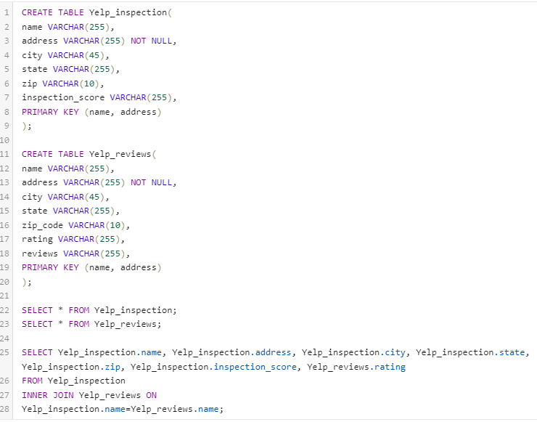
SQL Code

Slide 5
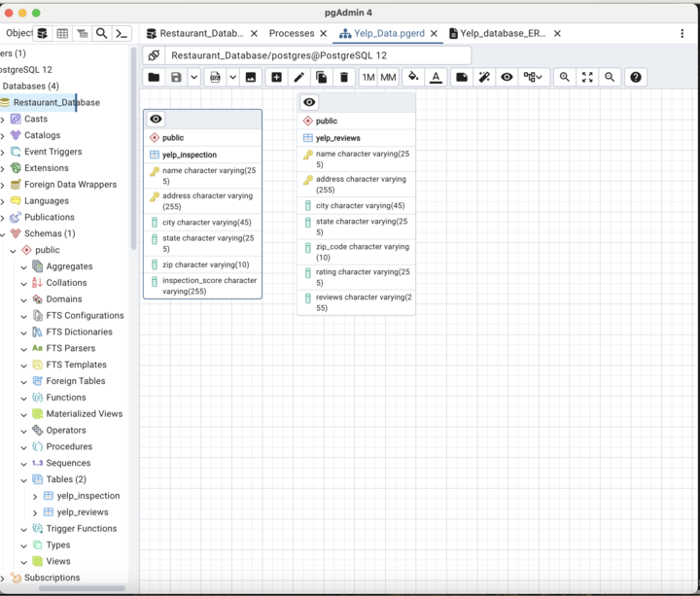
SQL ERD

Slide 6
Python Notebook Number 2: Plotting the data from SQL
See IPYNB file 2

Slide 7
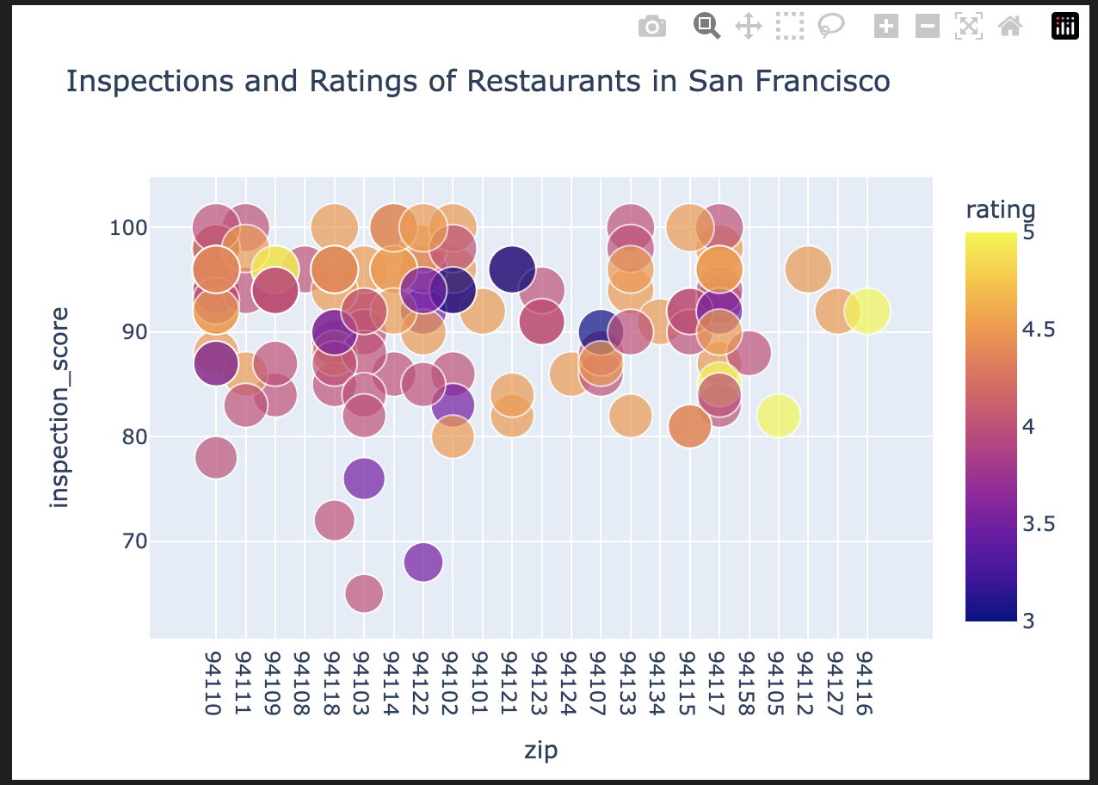
Data Plot
San Francisco shows favorable ratings overall, most rating fall between 4 and 4.5 stars
There’s very few restaurants with 5 stars
Zip codes between 94101-94017 have fewer recorded ratings than other areas. Additionally, this area is where most of the lowest ratings are recorded.

